Slide 2
CT Enhanced Shore Fishing Survey
11/07/2017
Gregory Wojcik
GSMFC / Discard Workshop

Slide 3
Enhanced Shore Fishing Program
Established in 2011 due to shore angler’s having a disproportionally low availability due to increasing minimum lengths.
46 shore fishing sites offer less restrictive fishing regulations.
2017- Summer flounder 17” vs 19” and Scup 9” vs 10”
Criteria to select sites:
  Boat Launch not present to reduce interaction with other modes of fishing that have more restrictive management measures.
  Open access to the public.
  Offer availability to scup and summer flounder

Slide 4
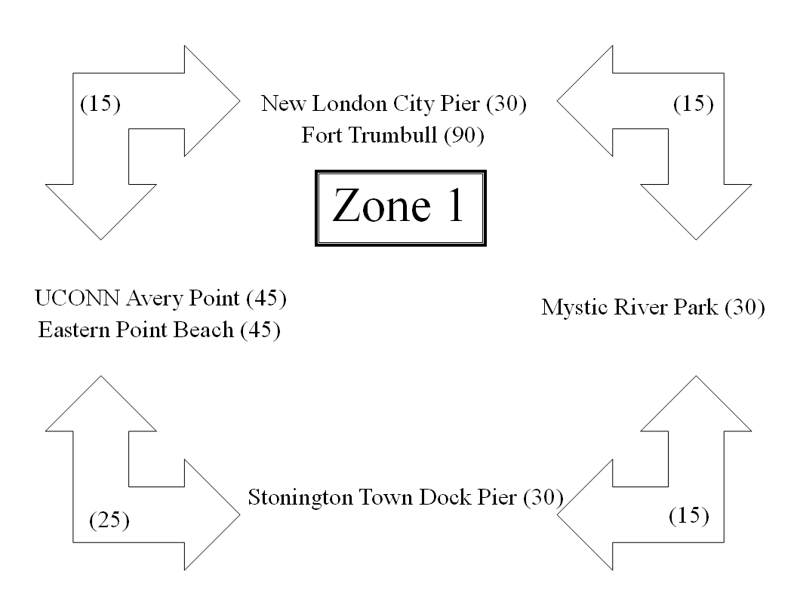
Enhanced Shore Fishing Survey
To help ensure the less restrictive regulations meet required conservation of the fishery management plan, a voluntary daily angler catch card program was developed.
Bus Stop Survey Design:
Randomly selected for each assignment:
  Zone covered (1 through 5)
  AM (6:00-13:00) vs PM (13:00-20:00)
  Starting Site within the Zone
  Direction traveled (clockwise vs counter-clockwise
Duration spent at each sites based on observed fishing pressures.

Slide 5
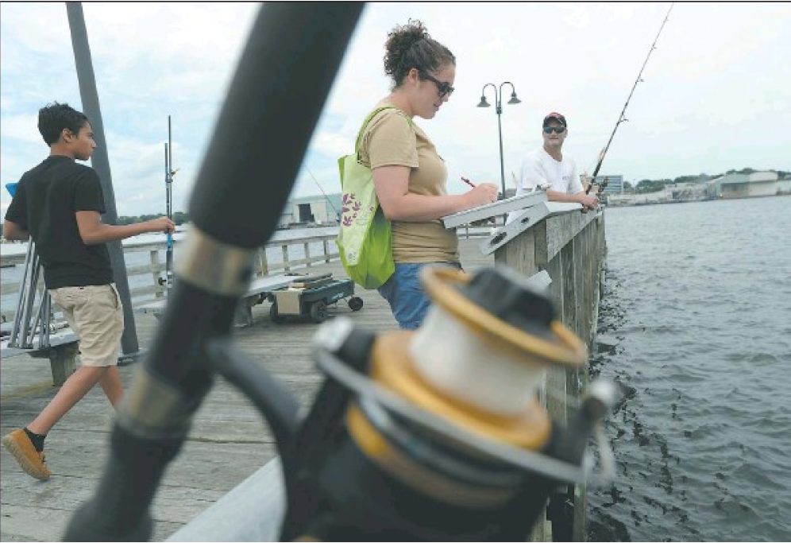
Enhanced Shore Fishing Survey
Upon arrival at the site the creel agent collects:
  Date and time creel agent arrival
  Weekend or weekday
  Site Name
  Initial count of anglers
  Arrival and departure time of additional anglers
  Date and time of creel agent departure
Partial Trip Interview Form
  Fishing Start time
  Targeted Species
  Avidity (number of annual trips)
  Comments/Suggestions about fishing sites
  Catch information (including reported discards)

Slide 6
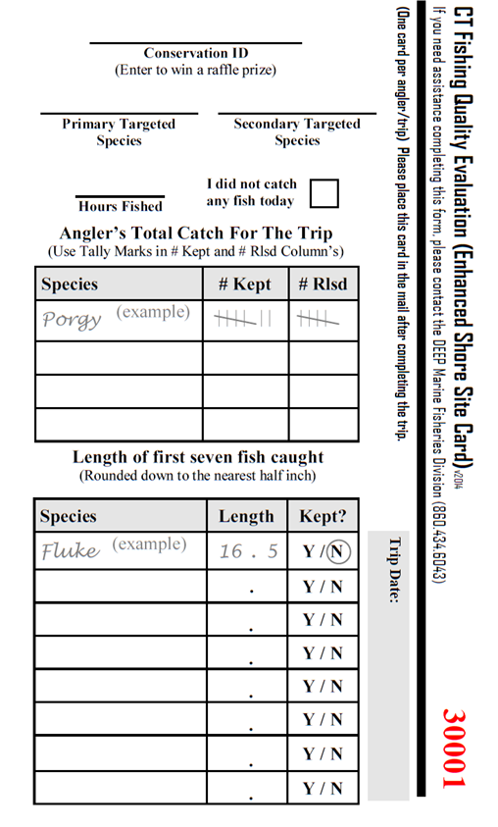
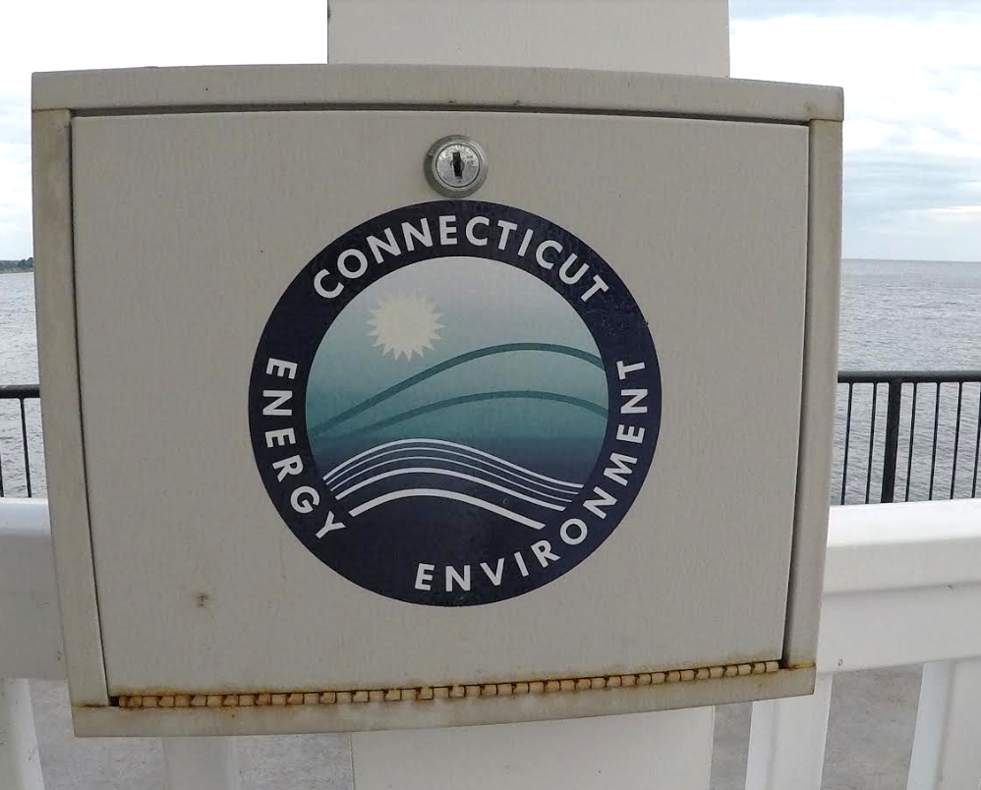
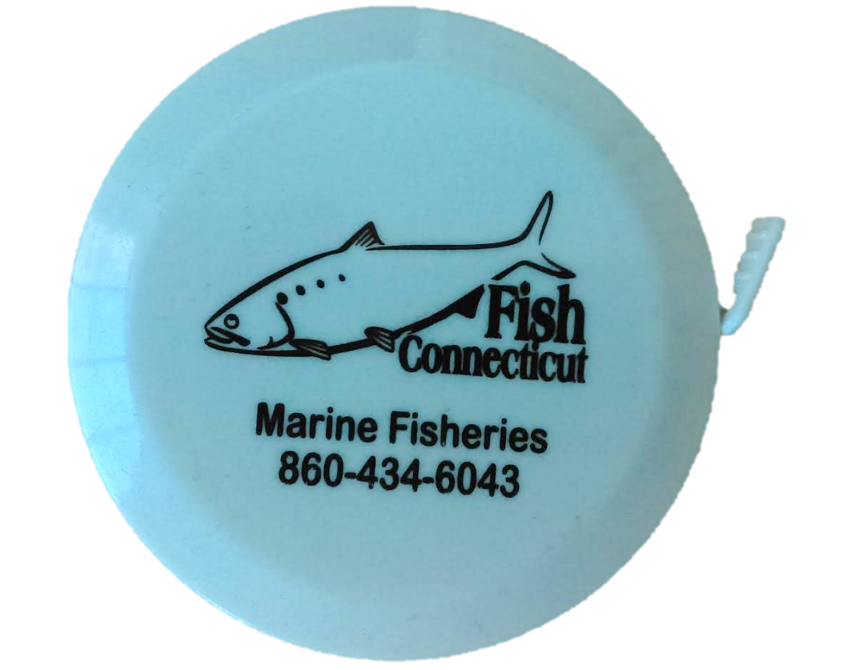
Enhanced Shore Fishing Survey
After the partial trip interview, the creel agent provides the angler with a catch card and tape measure to record the rest of the trips catch or all of the trip for anglers arriving after the creel agent.
Catch cards are returned to DEEP Marine Fisheries drop boxes located at the sites or via USPS (pre-paid).
Catch card data collected:
  Conservation ID (Linked to Marine Fishing License)
  Targeted Species
  Hours Fished
  Harvest and discard (numbers by species)
  Lengths and disposition (kept/released)

Slide 7
Some 2016 Results
877 Anglers intercepted (May – November) by 1 creel agent
Average Catch Card Return Rate= 35.5%
2016 number of lengths (Harvest and Discard) collected:
SPECIES | MEASURED BY ANGLER | MEASURED BY AGENT | TOTAL LENGTHS
ATLANTIC MENHADEN | 14 | 31 | 45
BLACK SEA BASS | 18 | 6 | 24
BLUEFISH | 74 | 59 | 133
CATFISHES | 9 | 8 | 17
CUNNER |  | 1 | 1
CLEARNOSE SKATE |  | 1 | 1
DOGFISH | 2 |  | 2
HICKORY SHAD | 28 | 8 | 36
NORTHERN KINGFISH | 1 | 1 | 2
SCUP | 129 | 229 | 358
SEA ROBIN UNC | 94 | 18 | 112
SKATE UNC | 2 |  | 2
SPOTTED HAKE | 1 |  | 1
STRIPED BASS | 58 | 8 | 66
STRIPED SEA ROBIN | 9 | 17 | 26
SUMMER FLOUNDER | 45 | 16 | 61
TAUTOG | 26 | 5 | 31
WEAKFISH | 4 | 1 | 5
WINTER FLOUNDER | 1 |  | 1
COMBINED TOTAL | 515 | 409 | 924

Slide 8
2014-2016 Discard Data by Species

Slide 9
Questions?
Contact Information:
Gregory J Wojcik
CT DEEP Marine Fisheries
Gregory.wojcik@ct.gov
860.447.4305

